Slide 1

Chess
Alberto Agugini, Casey Linden, Tunca Ozturk

Slide 2
Idea and Purpose of the project
Chess and computer science have been linked since the first attempts to build programs that can defeat humans (succeeded in 1996 IBM DeepBlue vs Kasparov)
Apps with more sophisticated interfaces do exist. That being said, we wanted to challenge ourselves intellectually by applying our Python knowledge to code our program.
We came up with the idea to code a simple chess program that allows two people to play the game on the same computer.

Slide 3

Features of the program
Allows two people to play the game by selecting and moving pieces through mouse clicks on a display
Draws all the possible moves of a selected piece on the board
Takes checks into account
Allows promotion, castling, and stalemate in the case no moves are possible for one side
10-minute timer for each side

Slide 4
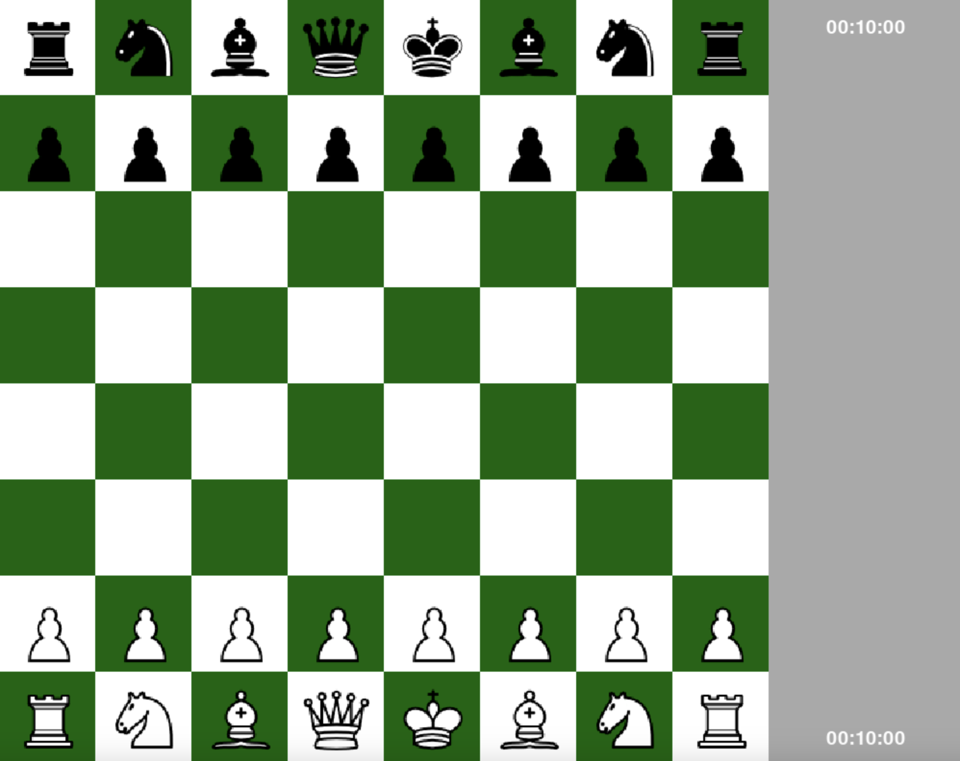
Display
screen = pygame.display.set_mode([WIDTH, HEIGHT])
display_board:
Creates the board through a loop that generates squares
display_pieces;
Loads the images of the pieces in the desired locations

Slide 5
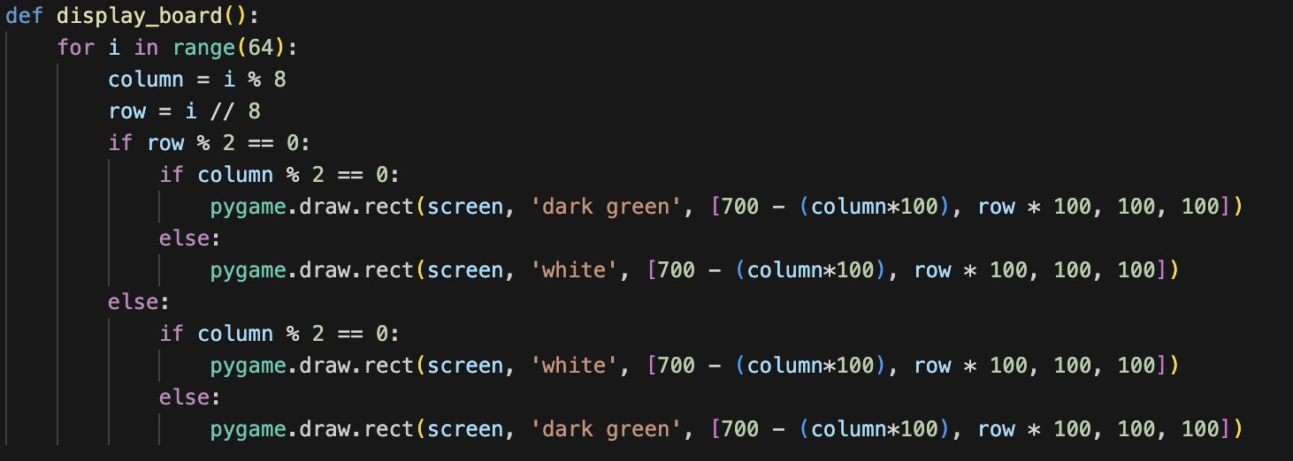

Slide 6
Game loop
It is a continuously running loop which allows the users to click and move the pieces on the board, calling many different functions that make sure the moves selected are possible.

Slide 7
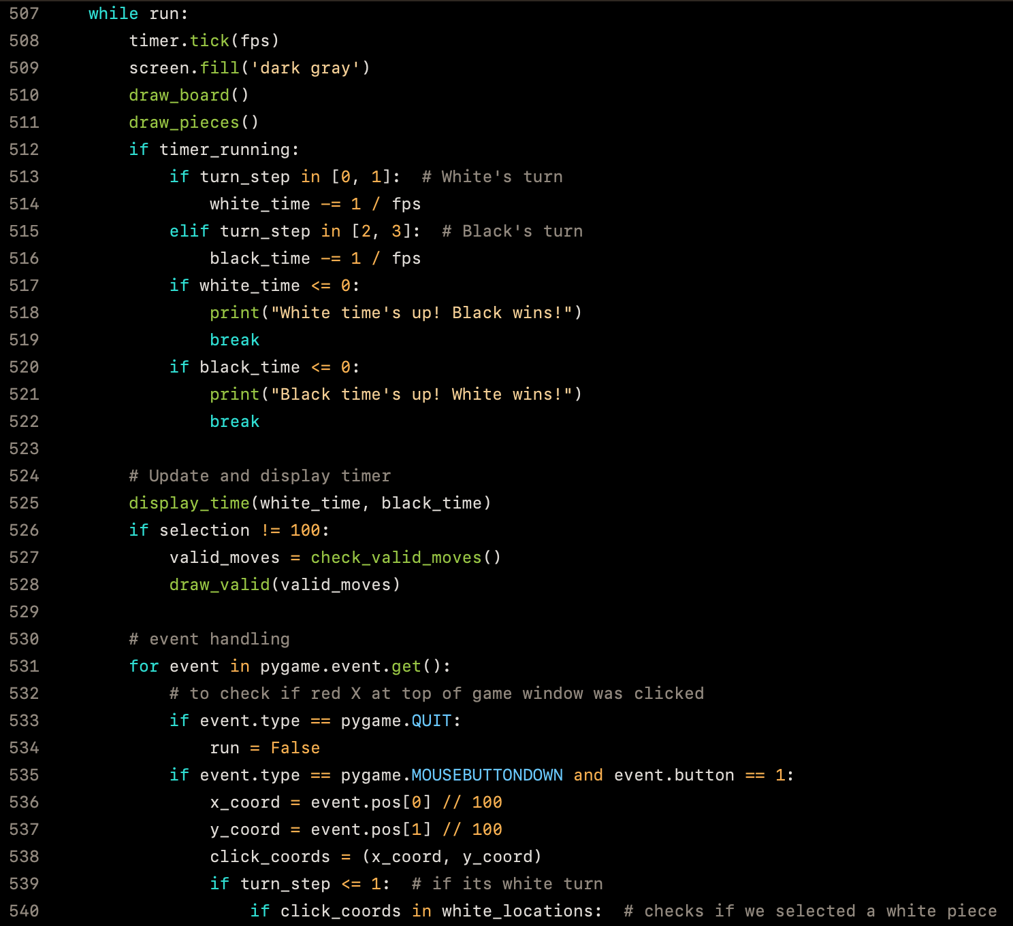
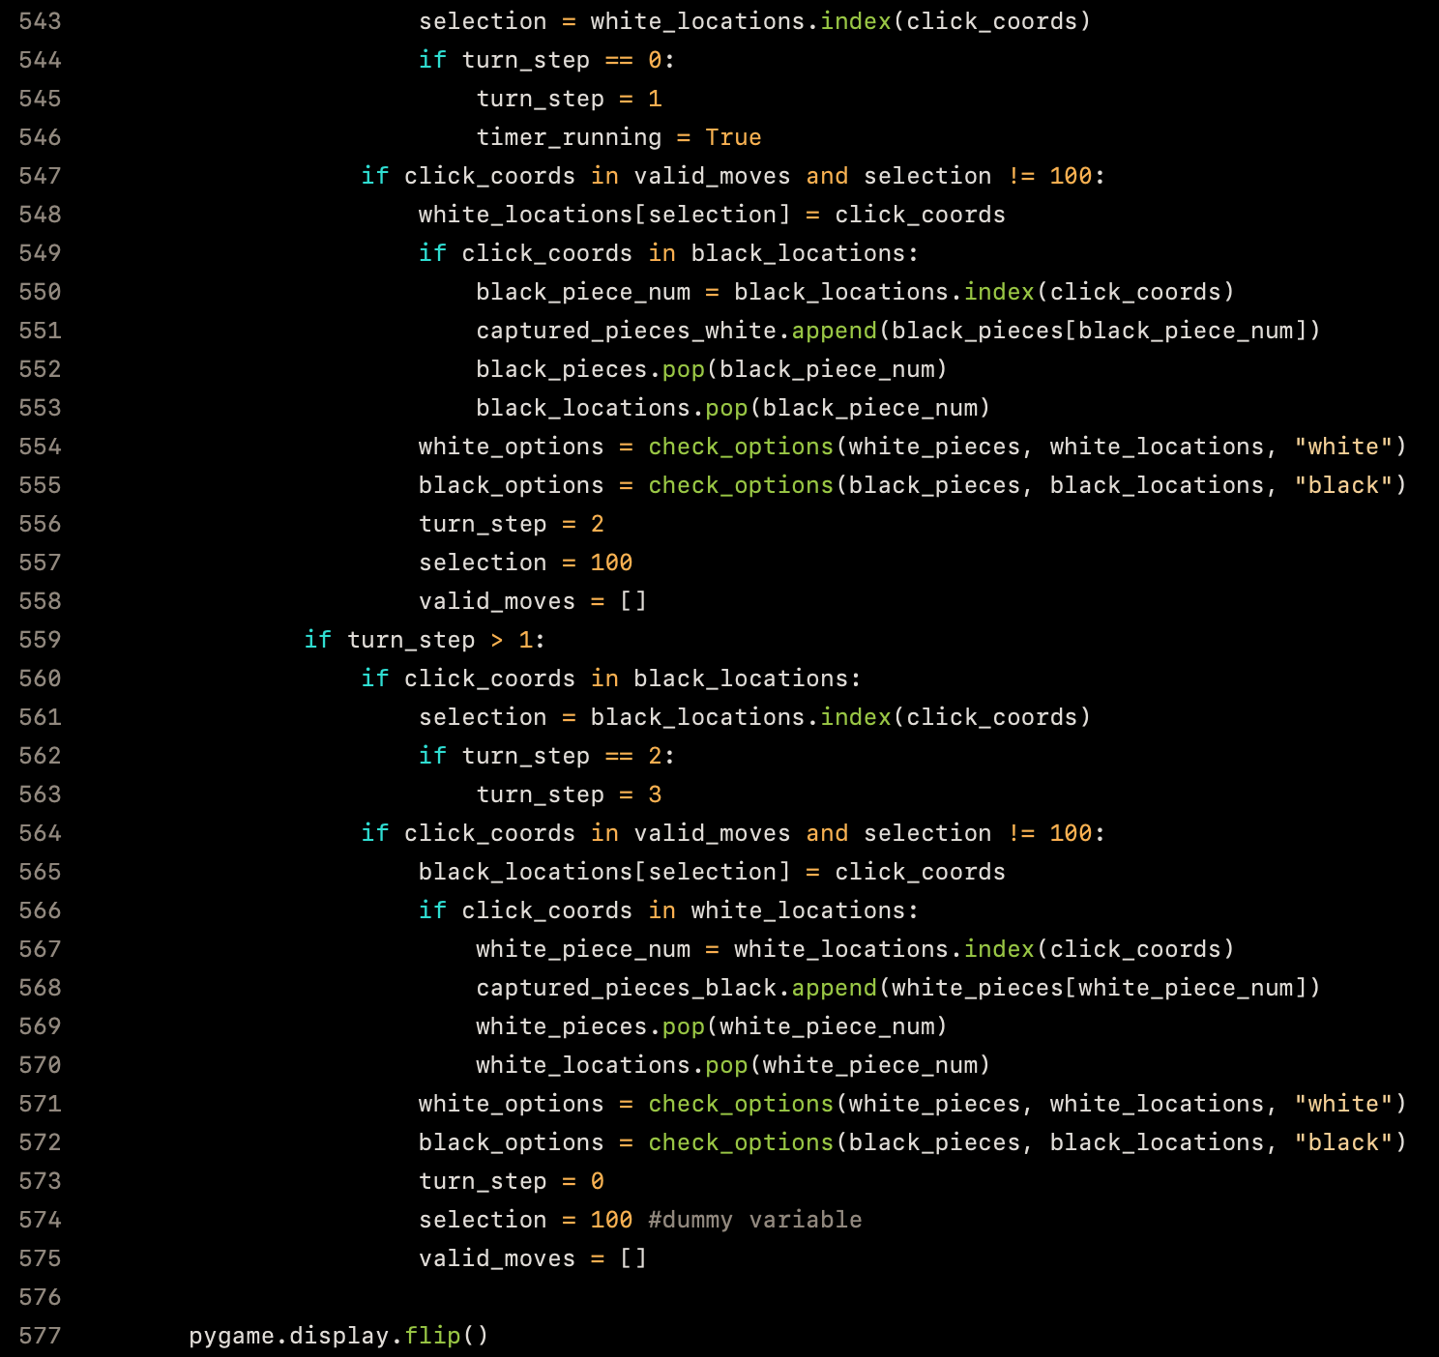

Slide 8
Coding the possible moves for every piece
Every piece moves differently in chess, but the procedure to code their possible moves is similar:
The program must understand how the piece moves and then check whether the target square is occupied by a same-color piece or by an enemy piece and that it is not outside of the board.
For some pieces, it is not even necessary to check whether the target square is occupied by an enemy piece or not (e.g. knight, king)

Slide 9
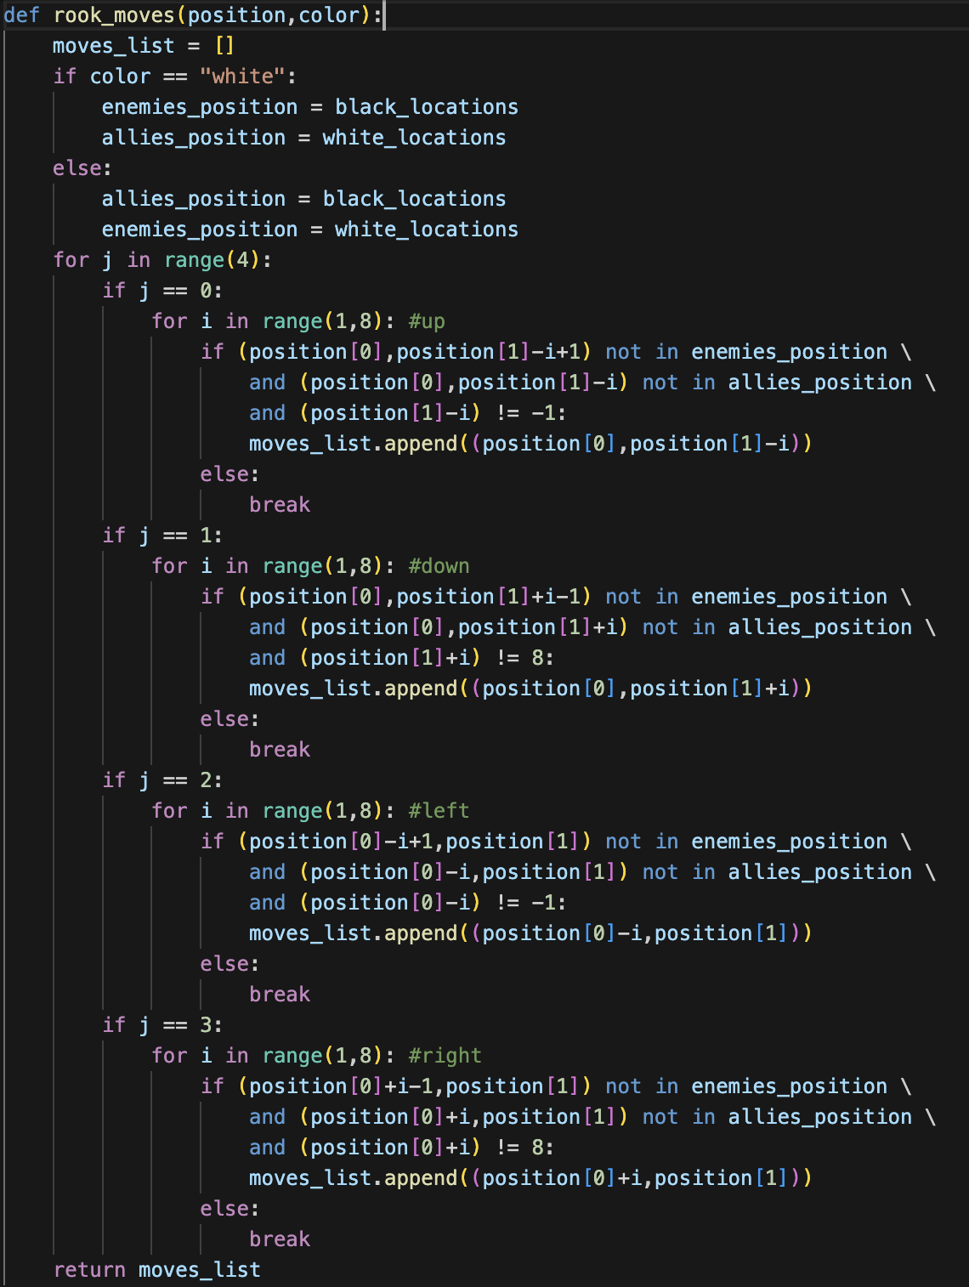
An example:
The rook

